Slide 1
Platinum Data Project Wang Biyuan
2016.08.02 Presentation

Slide 2
Project Progress
Step I: Import data into MATLAB 【Done+Improved】
Step II: Data interpolation 【Processing】
Step III: Data average 【To be done】

Slide 3

Project Progress
Recap: Step II Data Interpolation
Aim: ensure the consistency of data length
400
400
400
Notes:
By either truncation or interpolation

Slide 4
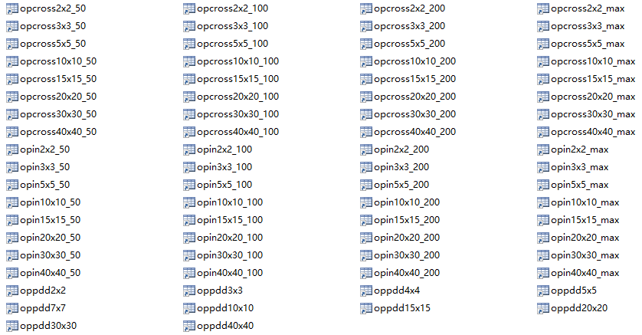
Project Progress
Recap: Step II Data Interpolation
Preparation :
Extracted raw data & Classified raw data
Data with the same category is ready for interpolation

Slide 5
Project Progress
Step II: Data Interpolation
Syntax: ynew=interp1(x,y,xnew) —— 1-D interpolation
Input:
X – sample points
Y – sample values
Xnew – query points
Eg. X = 0:pi/4:2*pi Y = sin(X)
X and Y satisfy a function（but not necessary） of one-one mapping relationship
Output:
Ynew – interpolated values at query points

Slide 6
Project Progress
Step II: Data Interpolation
Function: ynew=interp1(x,y,xnew)
X=axis;
Y=dose;
Xnew=x(1):0.1:x(end);
Ynew=interp1(x,y,xnew,’method’);
Method:
- Currently applied ‘spline’

Slide 7
Project Progress
Step II: Data Interpolation
Function: ynew=interp1(x,y,xnew)
Plot(xnew,ynew);
Hold on;
Plot(x,y);

Slide 8
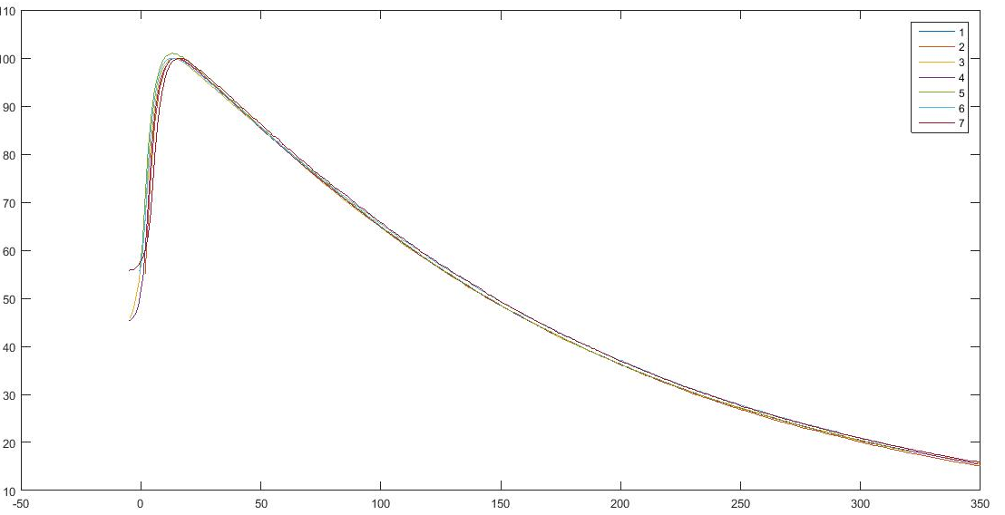
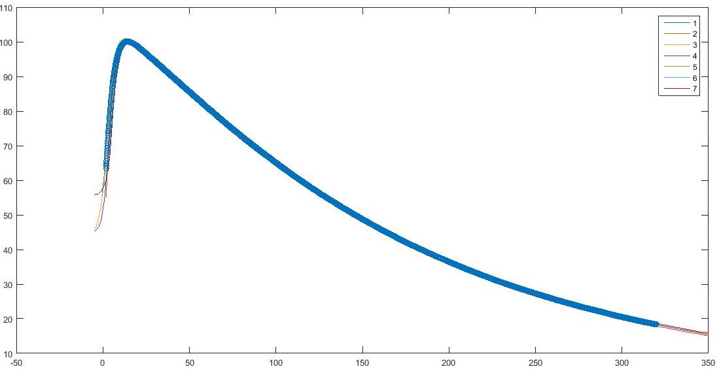
Project Progress
Step II: Data Interpolation
Function: ynew=interp1(x,y,xnew)
Raw data
Averaged data

Slide 9
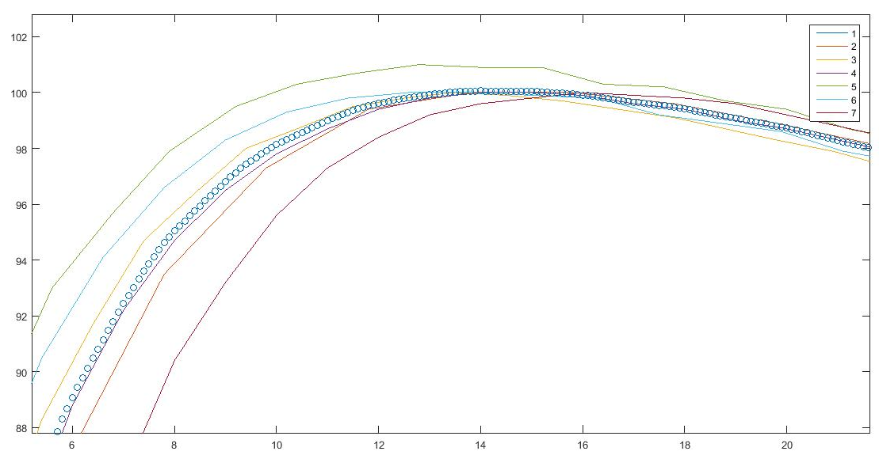
Project Progress
Step II: Data Interpolation

Slide 10
Project Progress
Step I: Import data into MATLAB
Improvement:
Previously: Nx6 matrix
Previously: Nx6 matrix
FSZ | FSZ | X | Y | Z | DOSE
Now: Nx7 matrix
FSZ | FSZ | X | Y | Z | DOSE | WEDGE

Slide 11
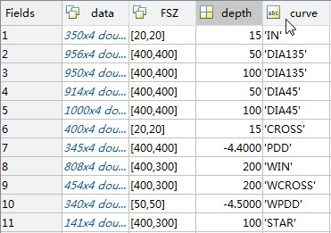
Project Progress
Step I: Import data into MATLAB
Improvement:
Import data from each file into one struct
Convenience of classification:
Avoid more for loops

Slide 12
Future Work Plan
The interpolation method anlysis
More Improvements of import data and classification functions

Slide 13
THE END Thank you for your patience!

